Slide 1
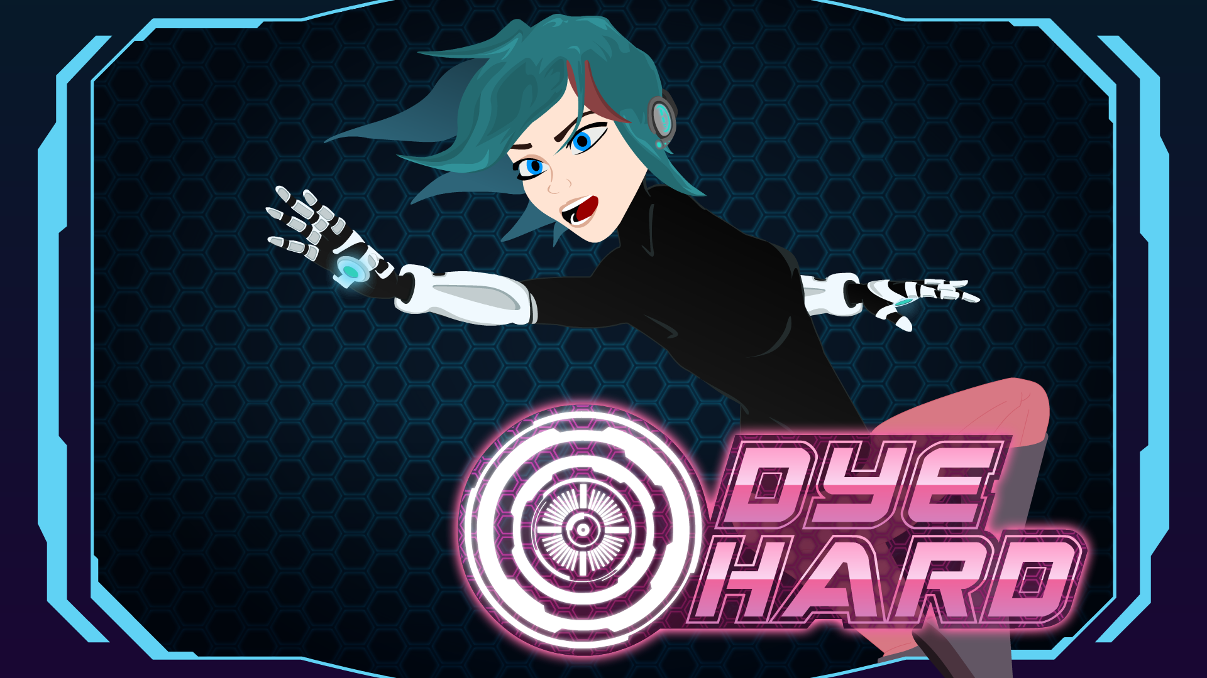
Educational
Game API
Advisor: Kelvin Sung
Sponsor: Rob Nash
Presenters:
Vuochly (Nin) Ky
Holden Woelfl

Slide 2

Project Overview
Design a tool for teaching computer science concepts based on a game API
Develop a procedural API based on the source code of an existing game
Reference materials for the API
Introductory computer science lessons
Part of an effort to bring CS to younger students
Notes:
The purpose of the project is to design an educational tool in the form of a game API
In the project, we developed a procedural API based on the source code of an existing game
We created reference materials for the procedural api
We designed and create the introductory computer science lessons
This project is part of an effort to bring programming education to younger generations of students.

Slide 3

Problems
Reach out and engage kids in programming
Teach them programming concepts using video game
Original Dye Hard game library is too complex for novice programmers
A simplified interface is needed

Slide 4
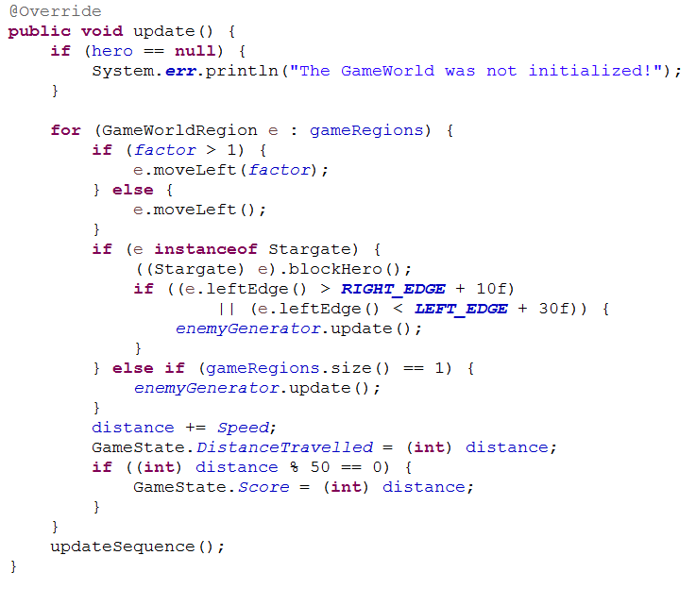
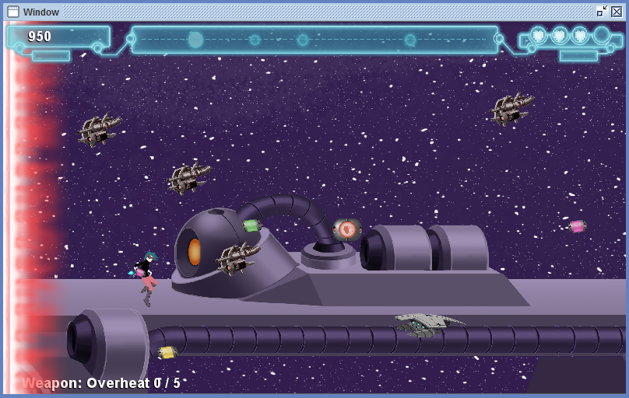
Dye Hard Original API
Written by other students
Object-oriented
Event-driven
Complex

Slide 5

What is our solution?
Notes:
The solutions are that...We want something simple;

Slide 6
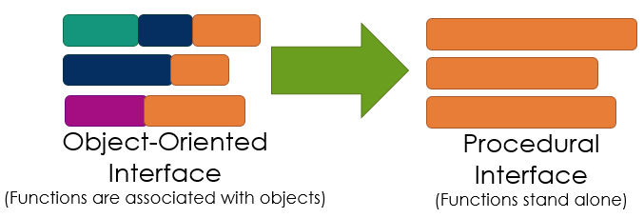
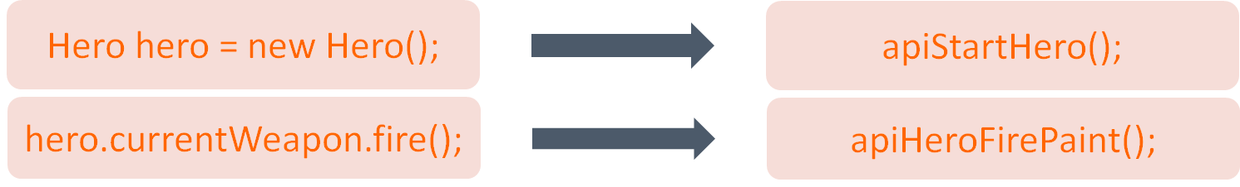
Dye Hard Procedural API
Simplify the user-facing code
Wrap object-oriented code in library of procedural functions
Notes:
We want to simplify the code, so we need to replace the object-oriented interface with a procedural interface
We also limit user exposure to callback functions
Only buildGame() and updateGame()

Slide 7
Dye Hard Procedural API -- the idea...
Object-Oriented
Functional
Hero hero = new Hero();
apiStartHero();
hero.currentWeapon.fire();
apiHeroFirePaint();
Notes:
The idea is that..For example, get rid of the object-oriented “new” keyword; and the “dot” to reduce complexity of user-written code

Slide 8
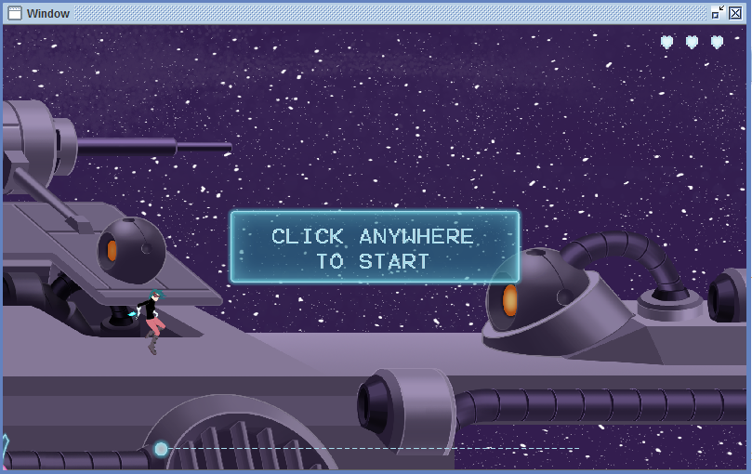
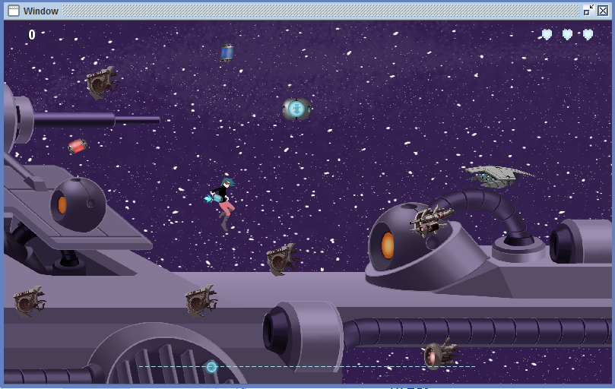
Reference Materials for the API
Demos
Intended for experienced users
Highlight and introduce how to work with API
6 demos

Slide 9
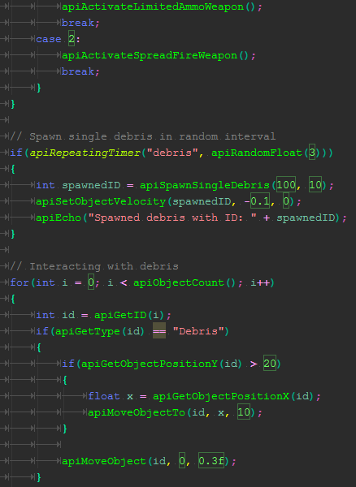
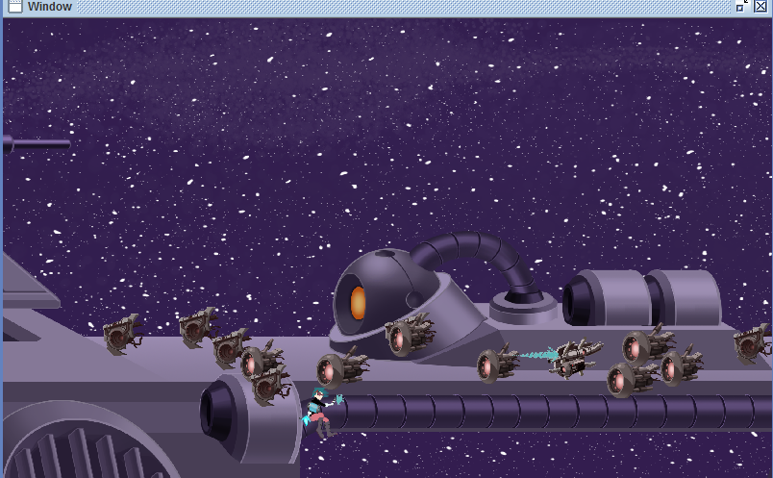
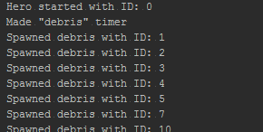
Reference Materials for the API

Slide 10
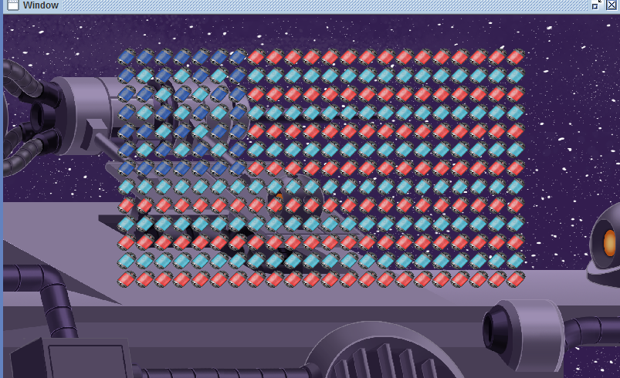
Teaching Materials
Labs
To teach computer science concepts
9 labs
Intended for novice users
Include lesson instructions for each lab
Notes:
This picture is an output of one of the labs. The task of this lab is to have students draw an American flag using nested for-loops.

Slide 11
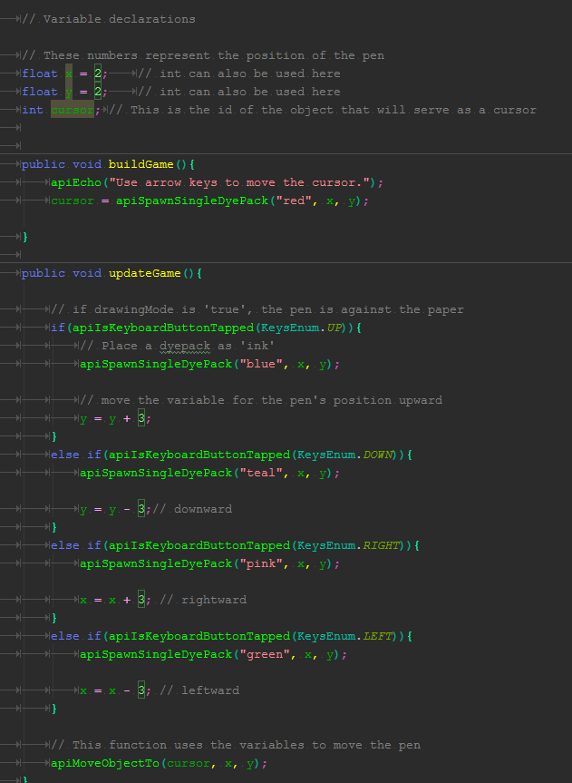
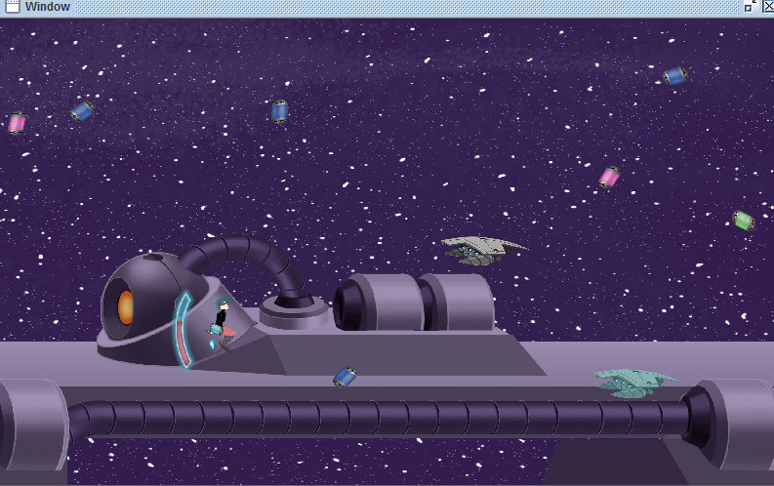
Teaching Materials

Slide 12
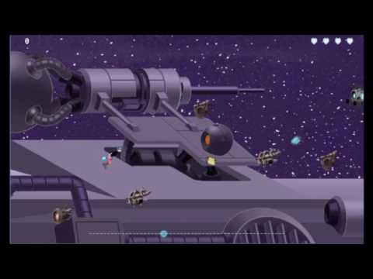
Procedural API Demo Game
Notes:
Here’s a short gameplay demonstration of a game similar to the original

Slide 13
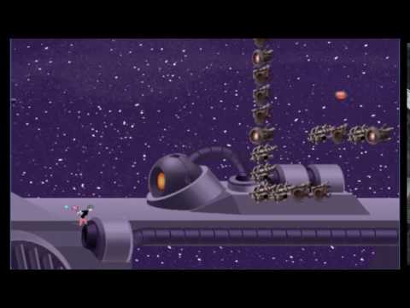
Short Maze Game
Notes:
A prototype for a maze game with multiple levels
This shows a possibility for alternate gameplay from the procedural api

Slide 14
Challenges Encountered
Understanding inherited codebase
Incomplete documentation
Needed bug fixes
Creating workarounds for esoteric behavior and implementations
Designing an effective educational tool

Slide 15
What We Have Learned
New tool -- Eclipse
Game Library Production
Team collaboration
Schedule and time management
Code documentations
Testing interface from user’s perspective
Notes:
Schedule and time management is very important because it helps us keep track of where we are.
Weekly meetings and reports -- Team collaboration
Implement API code
Test and refine the API
Make changes according to Feedback

Slide 16






Tools Used
Java
Eclipse
Intellij Idea
Github
Slack
Google Drive
Notes:
In this project, we used Java programming language.
For the IDE, I used Eclipse and Holden used Intellij.
We used Github for the source control.
We based most of our communication on slack.
And we created a shared folder on Google Drive use it to store for reports, schedule, and other shared files.

Slide 17

Acknowledgement
Kelvin Sung
Rob Nash
Janet McDaniel

Slide 18
Thank you!
Any questions?

